Slide 1
The Urban Drought
Adrienne Nakamura
Brandy Santa Cruz
Heather Strickland
Jesus Perez

Slide 2
Index
What are food deserts?
Food Deserts outside the US
Solutions
  Processed Foods
  Meal Prep
  Healthy Substitutions
Ted Talks
Closing

Slide 3
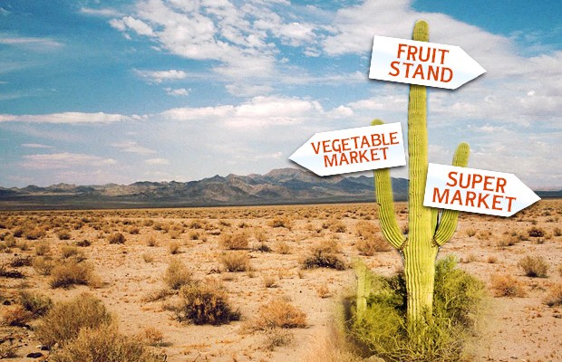
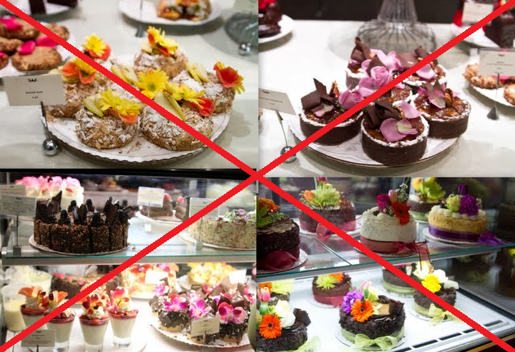
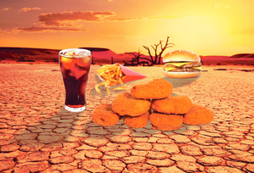
Food Deserts
No we don’t mean desserts!
Fig. 2 (Sweeny, 2014)
What are they?
Fig. 1 (Kirbie’s Cravings, 2012)
  Food Deserts are urban neighborhoods and rural towns without ready access to fresh, healthy, and affordable food.
  Instead of supermarkets and grocery stores, these communities may have no food access or are served only by liquor or convenience stores and fast food restaurants.
Fig. 3 (Madeline, 2013.)

Slide 4
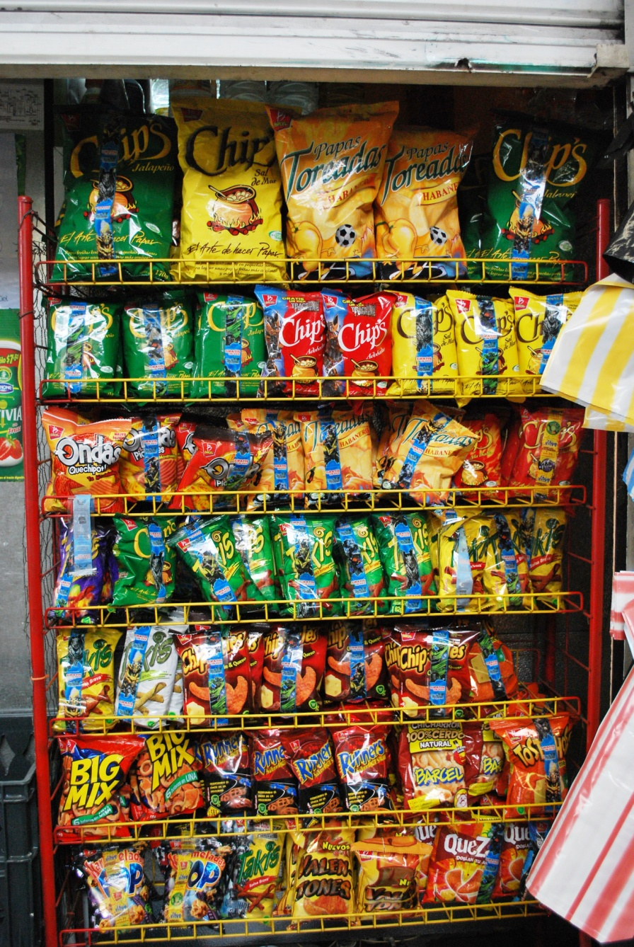
Food deserts on a global scale
Food Deserts Outside the US
UK and Canadian food deserts
Obesity levels worldwide
Fig. 4 (Garcia, 2009)

Slide 5
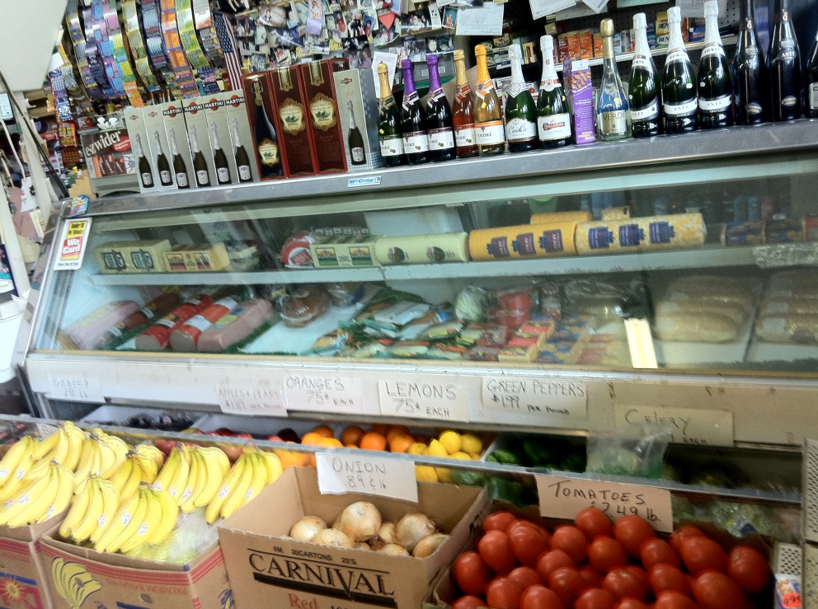
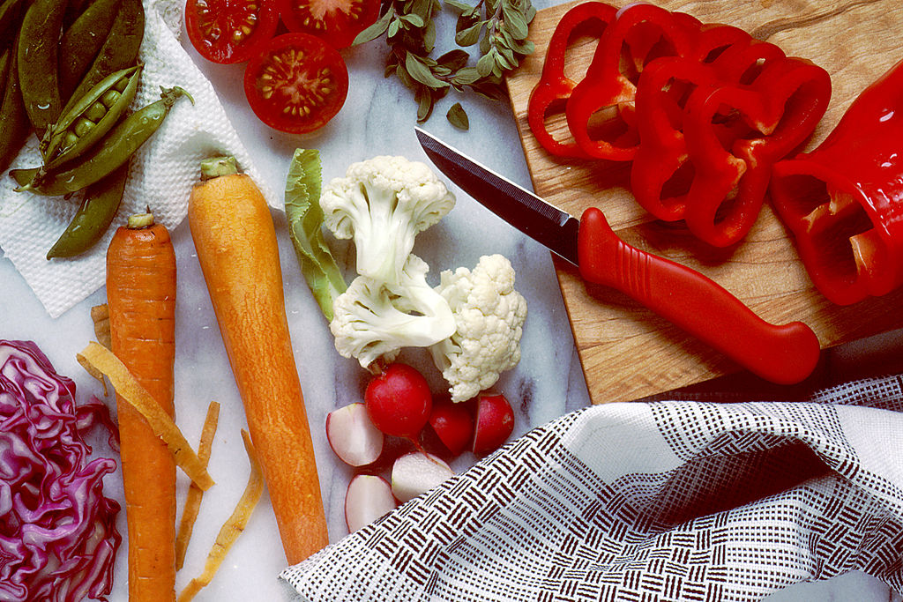
Solutions
Avoid processed foods
Fig. 5 (Are Food Deserts Exaggerated?, 2011)
Meal Preparation
Fig. 6 (National Cancer Institute, 1989)
Meal Preparation
Workout Tips

Slide 6
Turning into a healthy “foodie”
Some easy substitutions to make:
Your recipe says Use this instead It’s best used for
Food is culture
Substitutions are key to sustaining
Fig. 7 (Quick and Healthy Recipe Solutions, 2009)

Slide 7
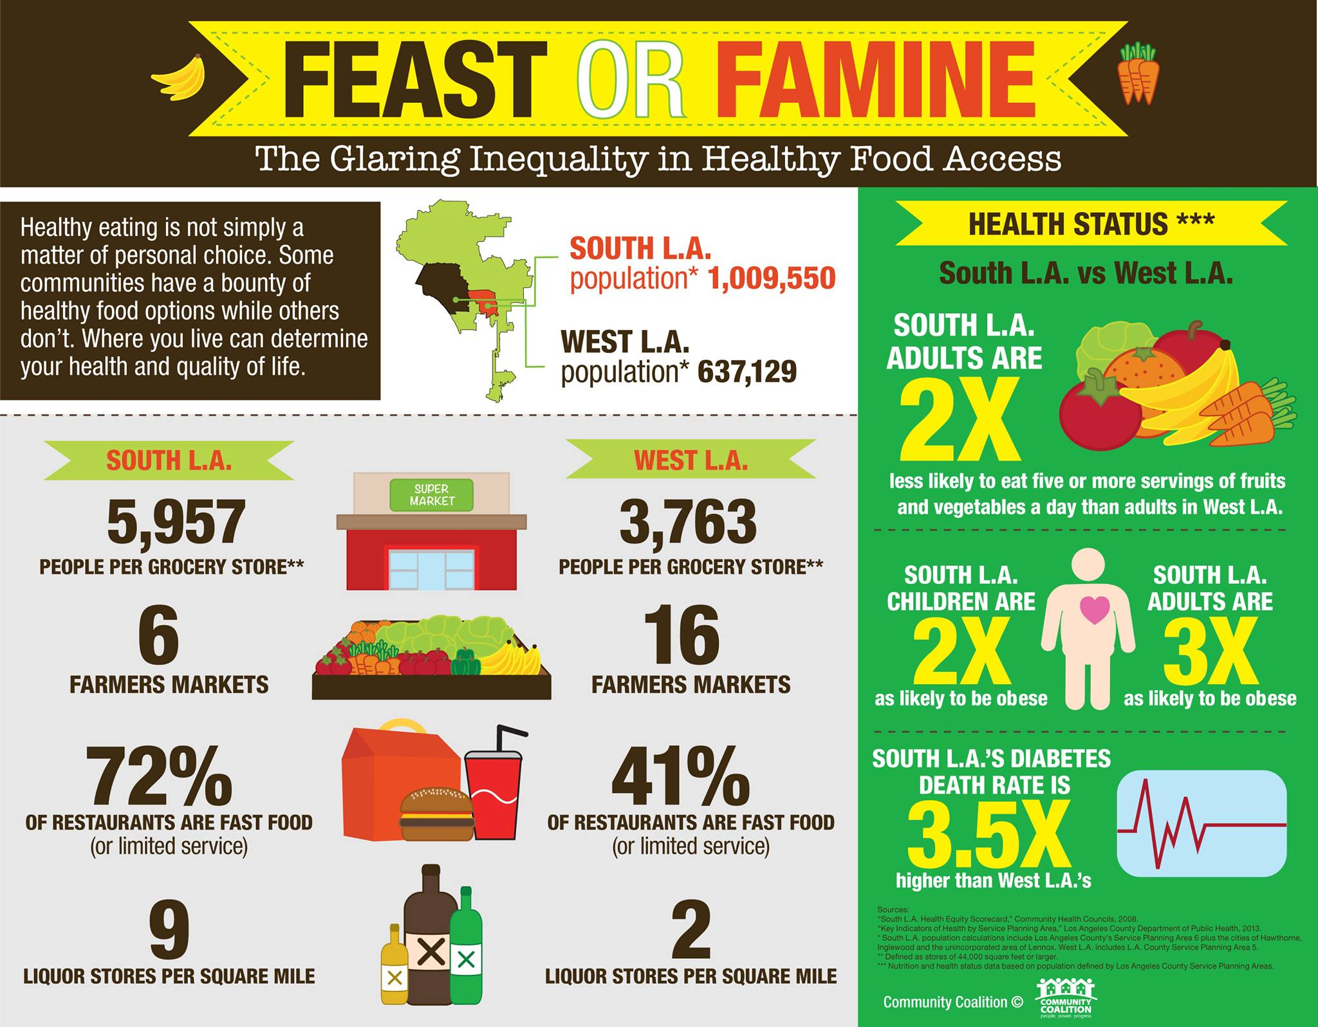
Los Angeles Comparison
Fig. 8 (Community Coalition, 2013.)

Slide 8
Ted Talks – The Guerilla Gardener
Ron Finley’s Presentation on Ted Talks
https://www.youtube.com/watch?v=EzZzZ_qpZ4w

Slide 9
Works Cited
Are Food Deserts Exaggerated? (2011). RustWire. [Image] Retrieved from http://rustwire.com/2011/05/17/are-food-deserts-exaggerated/
Community Coalition. (2013). Feast or Famine. [Image]. Retrieved from https://www.facebook.com/photo.php?fbid=10151471617191822&set=a.397327441821.1 80108.109065376821&type=1&theater
Garcia, A. (2009). Snack Food Rack. Wikipedia.com. [Image]. Retrieved from http://commons.wikimedia.org/wiki/File:SnackfoodRackDF.JPG
Quick and Healthy Receipe Solutions.(2009). Better Homes and Gardens. Retrieved from: http://www.hearthealthyonline.com/healthy-recipes/cooking-nutrition-tips/healthy- recipe-substitutions_ss16.html
Sweeny, E. (2014). The Struggle to Create Oases in Food Deserts. Consumer Eagle. [Image]. Retrieved from http://www.consumereagle.com/2014/04/01/the-struggle-to-create- oases-in-food-deserts/
Madeline. (2013). You’re What You Eat. b-ethics. WordPress. [Image]. Retrieved from http://bizgovsoc8.wordpress.com/2013/10/16/we-cant-tell-people-to-buy-fresh-food- if-there-is-no-place-to-buy-it-michelle-obama/
National Cancer Institute. (1989). Vegetable Preparation. [Image]. Retrieved from http://commons.wikimedia.org/wiki/File:Vegetable_preparation.jpg

